Slide 1
ROAD CONSTRUCTION
Description Modules
1. Code: CET 04106
2. Name: Road Construction
3. Number of Credits: 6
4. Sub-enabling Outcomes
Perform simple route alignment for simple roads.
Construct simple drainage structures for earth, gravel roads.
Select suitable types of soils for construction of earth, gravel roads.

Slide 2
Sub-enabling Outcomes continues……
Prepare sub-grade soil to the required road formation, and surface it with a gravel wearing course by using both machine and labour based technology.
Install road furniture

Slide 3
Learning Context
Explain the historical background of roads (paved and unpaved roads)
Identify type of roads
Explain types of roads
Route alignment of simple roads:
Describe obligatory points for route location
Construction of earth, gravel roads:
Explain the Procedures and techniques for construction of earth, gravel roads
Perform Mechanical soil stabilization
Construct earth, gravel roads

Slide 4
Learning Context Continues….
Construction of drainage system:
Explain the Procedures for constructing cross and side drains and turnouts
Construct drainage system for earth, gravel roads
Road furniture:
Identify different types of road furniture
Identify points of installation of road furniture
Install road furniture

Slide 5
7. Learning Materials
Audio/visual, power point slides and site visit.
Reference
THE UNITED REPUBLIC OF TANZANIA – MINISTRY OF WORK (1999). Pavement and material design manual.
Road Note 31
Khanna S.K. and Justo C.E.G (1991) High way engineering (7th Edition) Nem Chand and Bros. Civil Lines, Roorkee. India.

Slide 6
Integrated Method of Assessment
The module will be assessed through assignments, test and end of semester examination.
Continuous assessment Components 40%
Final Examination 60%

Slide 7
INTRODUCTION
What is a road?
A way to get from Point A to Point B
Clear of vegetation and other obstacles.
Constructed of material that holds up against the forces of weather and traffic.
Shaped to keep water off, and away from the traveled way.

Slide 8
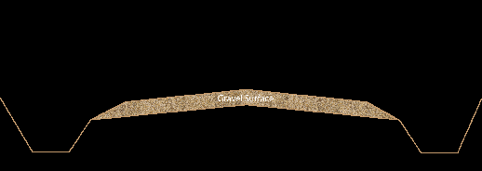

Slide 9
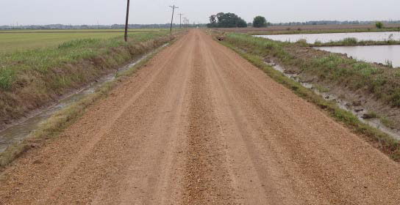

Slide 10
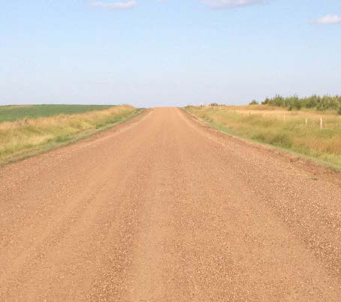

Slide 11
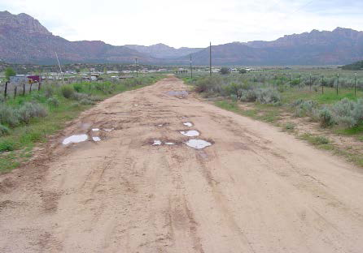

Slide 12
Types of Roads
There are two types of roads according to the finished surface
Paved Roads
Unpaved roads
Paved roads
Any road that has a semi-permanent surface placed on it such as asphalt or concrete.
Unpaved roads divided into two groups
Gravel road is a type of unpaved road surfaced with gravel that has been brought to the site from a quarry or stream bed.

Slide 13
Earth road: is a type of unpaved road made from the native material of the land surface through which it passes

Slide 14
ROUTE LOCATION
Route Location Survey
The aim of location survey is to select a route with the following points kept in mind.
With reasonable economy it should meet the minimum requirement regarding curvature and grades.
To produce an easy riding (traveling), free flowing traffic artery that has a high capacity and it meets all the safety standards.

Slide 15
The location survey should recognize and evaluate the routes impact on already existing industries, business, and residential values and on future development.
Before field survey for any highway location is started, tentative decision, regarding the design speed of the route, its cross-section, and the maximum grade must be made. These decision made are based on the;

Slide 16
Estimated of amount, character and hourly distribution of traffic, along with
Knowledge of the area is traversed.
And available funds
RESULTING ROUTE: After comparison of the different alternative design, the route is selected which has cheapest overall cost, considering capital investment, maintenance, expense and saving to the road user.

Slide 17
Route alignment of simple roads
Tools used for road setting out:
tape measure,
pegs and
strings

Slide 18
Horizontal alignment of can be set out as a number of straight lines. These straight lines are later on joined by curves. See Figure below 1

Slide 19
A parabolic curve can be set out as shown in figure 2 below. This curve should be set out from equal tangents, so that the steeper portion is not pushed nearer to one tangent than to the other.

Slide 20
The method of setting out is as follows:
(1) The point of intersection of the tangents (D) is determined. Then, the most suitable length of the tangents is set out and measured;
(2) Pegs are put to show the tangent points B and C;
(5) Each tangent is divided into equal number of parts and numbered as shown above;

Slide 21
(4) The points on the curve are found as the intersections of lines 1-1 with 2-2, 2-2 with 3-3 and 3-3 with 4-4.
After setting out the road centerline, it is necessary to put in sufficient reference pegs to enable it to be relocated as and when required, and to control its level during construction.

Slide 22
After setting out the road centerline, it is necessary to put in sufficient reference pegs to enable it to be relocated as and when required, and to control its level during construction.

Slide 23
ROADWAY CROSS SECTION
There are three basic elements of roadway cross section
1. A crowned/camber driving surface,
2. A shoulder area that slopes directly away from the edge of the driving surface, and
3. A ditch.

Slide 24
camber
A proper camber ensures water will drain off the roadway surface during a rain event. Without it, water will quickly collect on the road surface during a rain and will soften the surface material.
Water retained in the roadway surface can lead to rutting, which can extend down into the subgrade.
Therefore, a properly drained gravel road must have a sufficient or adequate cross slope

Slide 25
Too much crown in the road surface can lead to an unsafe condition.
The traveling public may have difficulty staying “in their lane.” Due to an excessive crown, drivers begin to feel a slight loss of control as their vehicle wants to slide towards the shoulder.
For these reasons, roads with excessive crowns will encourage road users to depart from their travel lane and drive in the middle of the road regardless of how wide the lane or roadway may be.

Slide 26
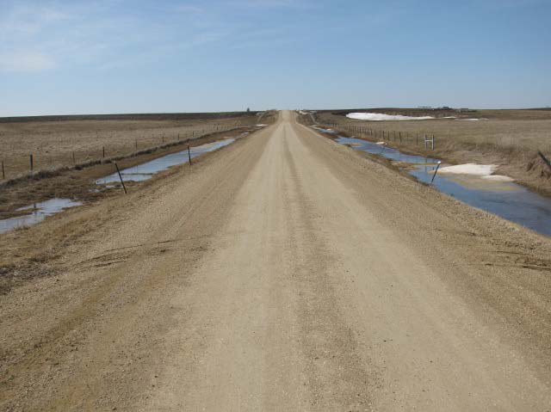
A road that is wide (7.5m surface width) yet everyone drives in the middle. The primary reason is excessive crown.

Slide 27
Reccommended camber
Supervisors and skilled operators across the country indicate that approximately 4 percent on the cross slope is highly recommended.
While it is virtually impossible for any operator to maintain an absolutely uniform camber, minimal deviation is recommended.
It is not good to exceed 6 percent in any condition.

Slide 28
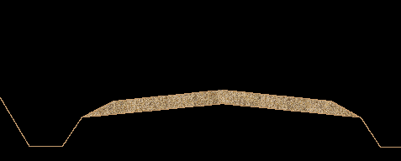
Correct camber

Slide 29
Super elevation
Super elevation is tilting the roadway to help offset centripetal forces developed as the vehicle goes around a curve. Along with friction, they are what keeps a vehicle from going off the road.
Must be done gradually over a distance without noticeable reduction in speed or safety

Slide 30
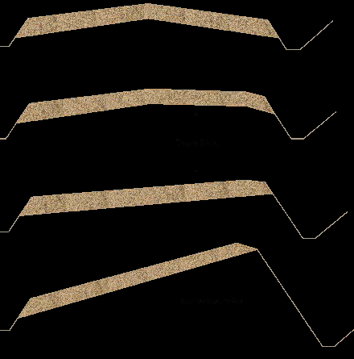
Camber to superelevation transition.

Slide 31
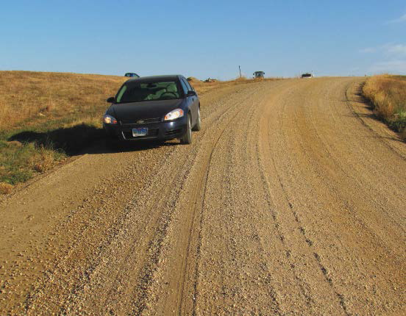
Wrong shape on curve which increases risk of crashes.

Slide 32
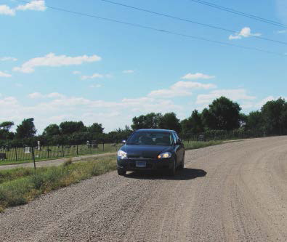
Well-shaped superelevation on a curve.

Slide 33
Road Shoulder
The road shoulder serves several essential
functions.
Primarily, it supports the edge of the traveled portion of the roadway.
Another important function is to provide a safety area for drivers to regain control of vehicles, if forced to leave the road surface.
The shoulder also plays an important role in drainage, carrying water further away from the road surface towards the foreslope and into the ditch.

Slide 34
In order for the shoulder to perform all of these functions, its shape is critical.
First, the shoulder should meet the edge of the roadway at the same elevation. In other words, the shoulder should begin no higher or no lower than the edge of the roadway.

Slide 35
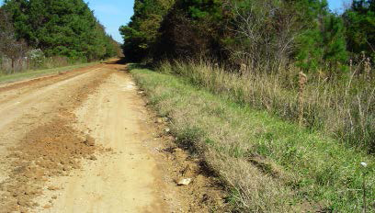
Another severe secondary ditch (high shoulders) caused by gouging with the motor grader moldboard.

Slide 36
Ditch
Drainage of water from the road surface to a ditch is very important for maintaining the design life of the road.
The most important and common drainage feature needed on a rural road is the roadside ditch.
Every effort must be made to maintain at least a minimal ditch throughout

